Slide 1
Automatic tagging system
Group - 10

Slide 2
Problem definition
Designing an automatic question tagging system that can automatically identify correct and relevant tags for a question submitted by the user.

Slide 3
Objective
Sites that are specifically designed to have questions and answers for their users like Quora and Stackoverflow often request their users to submit five words along with the question so that they can be categorized easily. But, sometimes users provide wrong tags which makes it difficult for other users to navigate through.That is why we propose to design a question tagging system.

Slide 4
Abstract
Online question and answer forums such as Stack Exchange and Quora are becoming an increasingly popular resource for education. Central to the functionality of many of these forums is the notion of tagging, whereby a user labels his/her post with an appropriate set of topics that describe the post, such that it is more easily retrieved and organized. We propose a multi-label classification system that automatically tags users questions to enhance user experience.

Slide 5
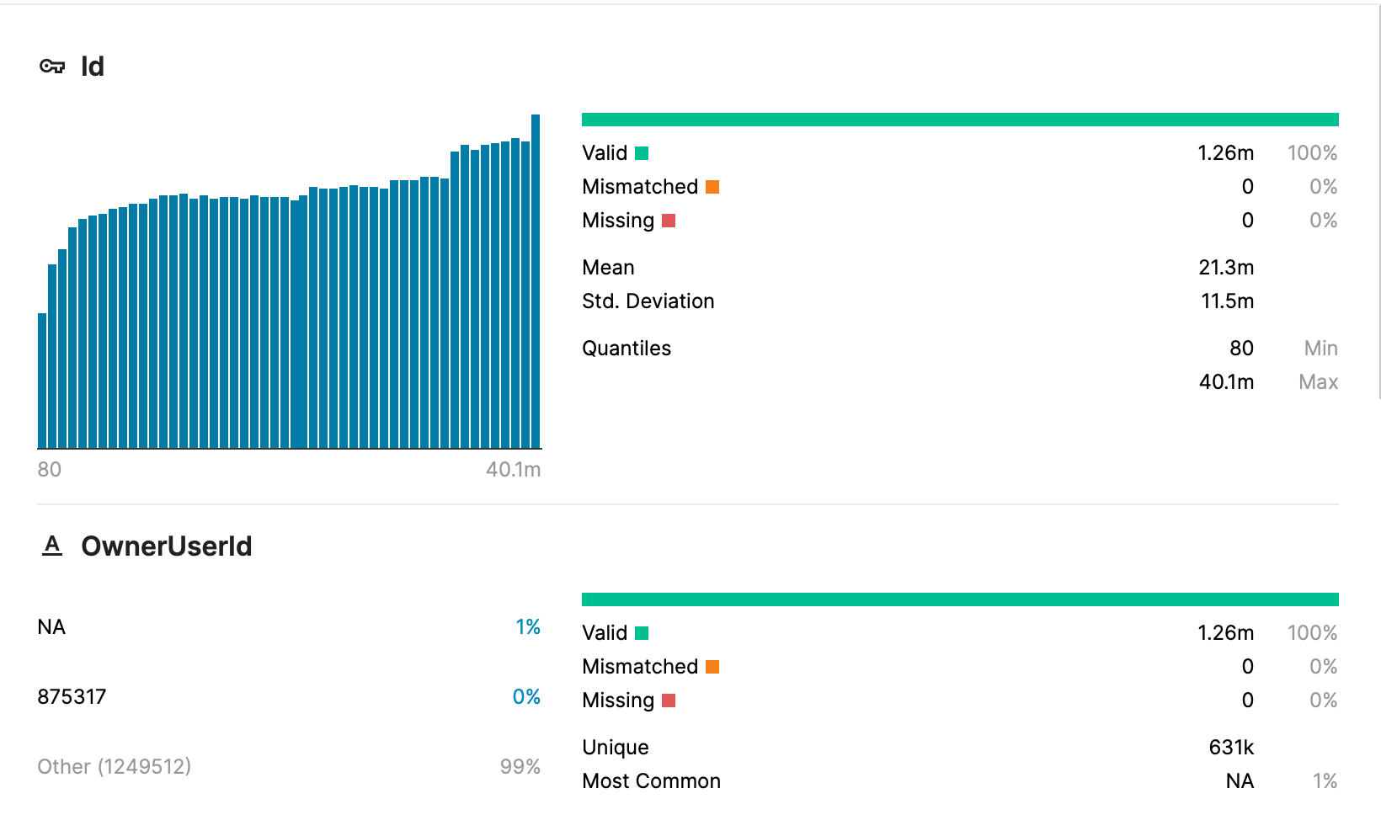
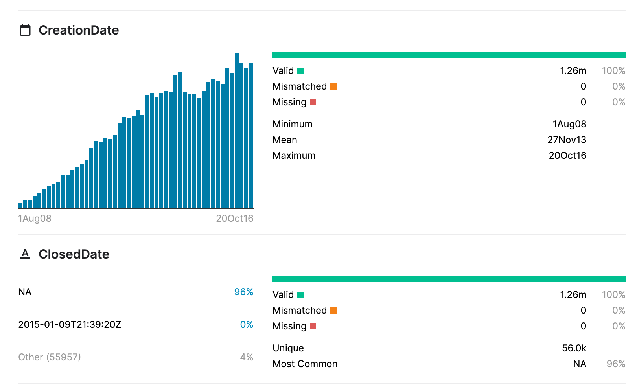
Dataset
Questions contain the title, body, creation date, closed date (if applicable), score, and owner ID for all non-deleted Stack Overflow questions whose Id is a multiple of 10.

Slide 6
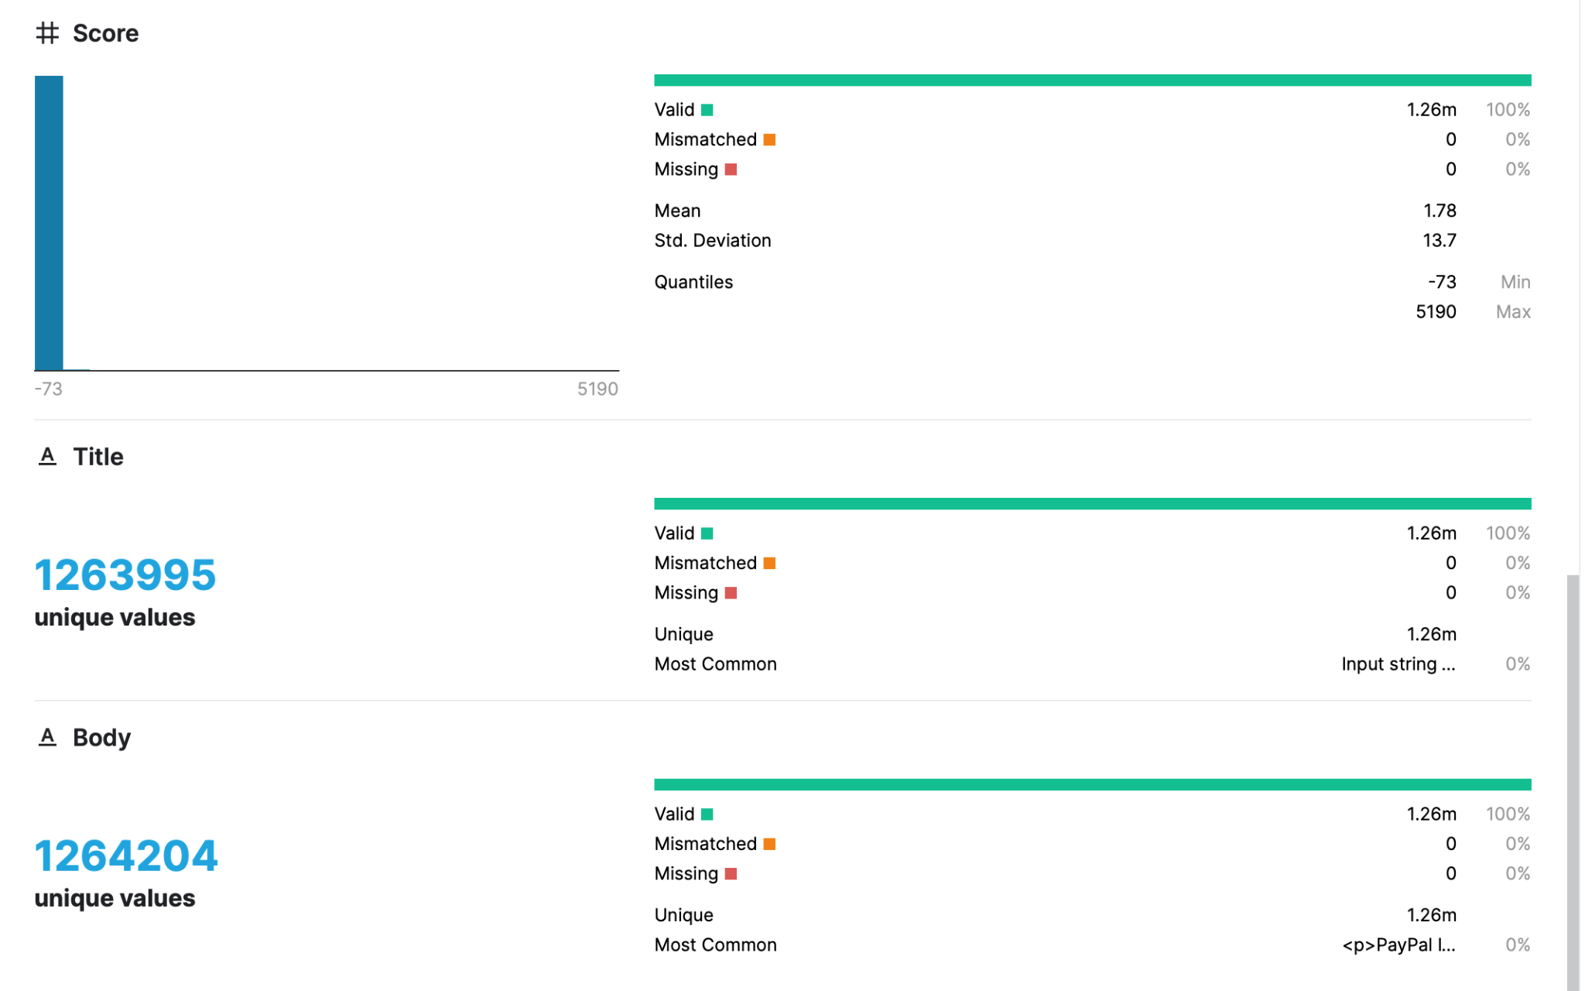
Dataset
cont…

Slide 7
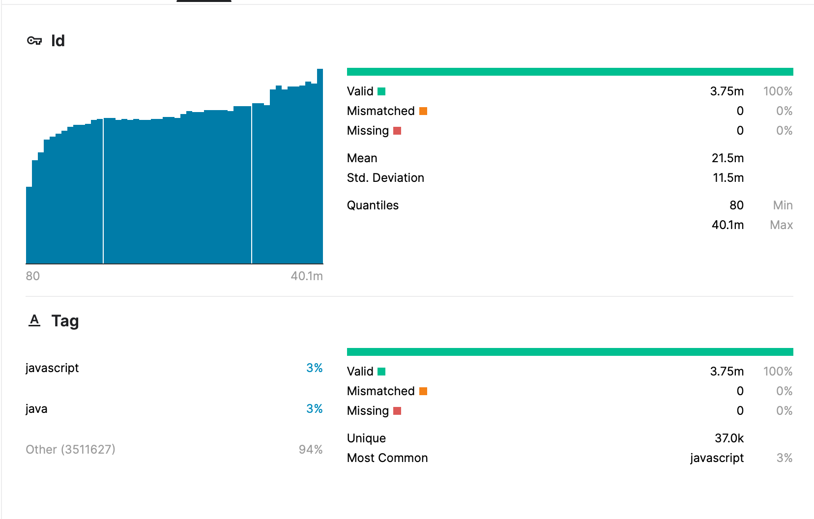
Dataset
Tags contains the tags on each of these questions

Slide 8
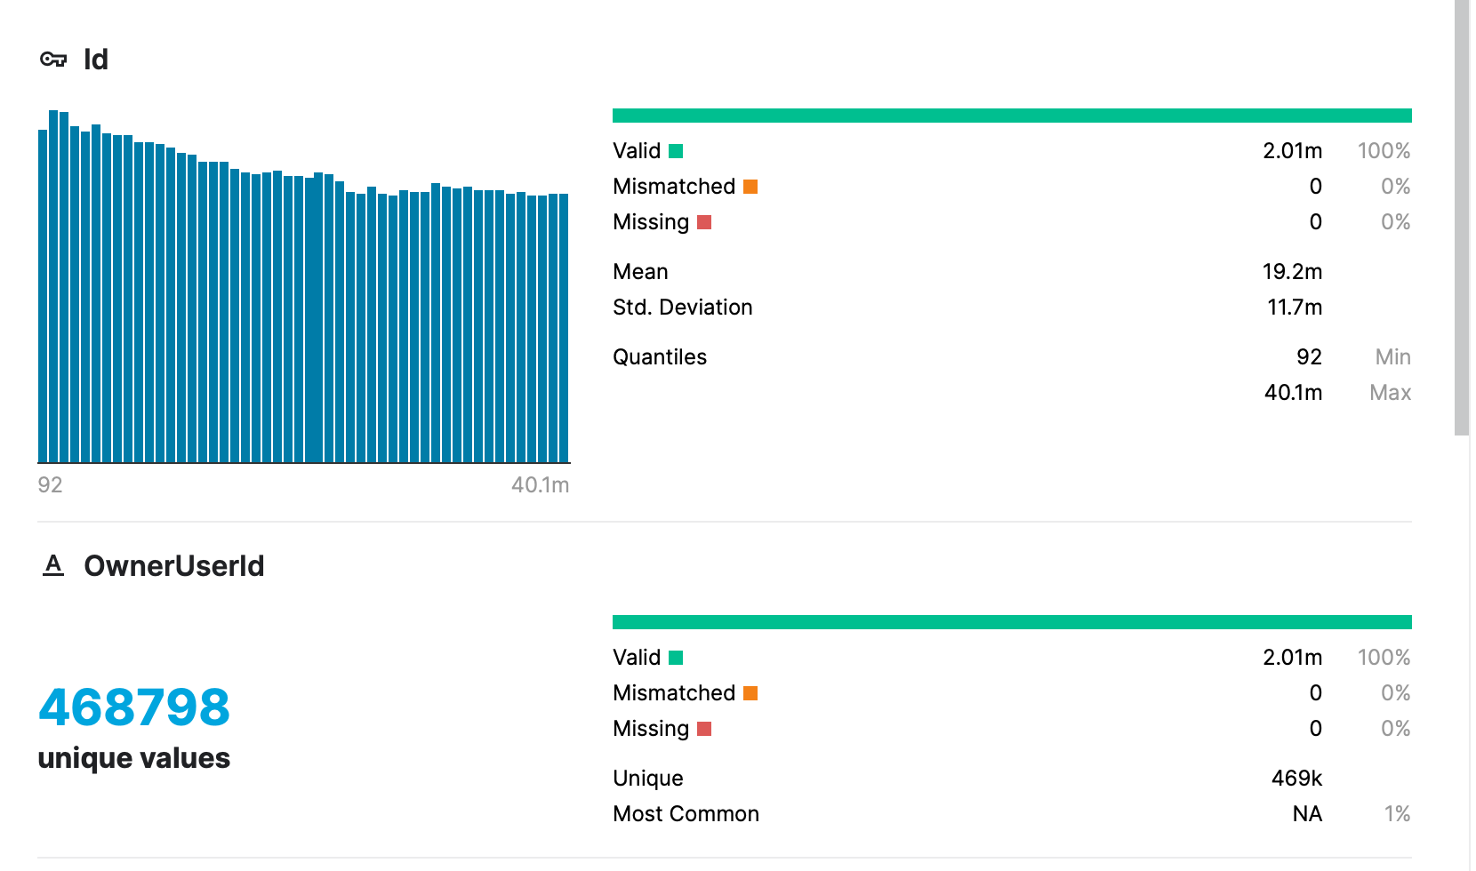
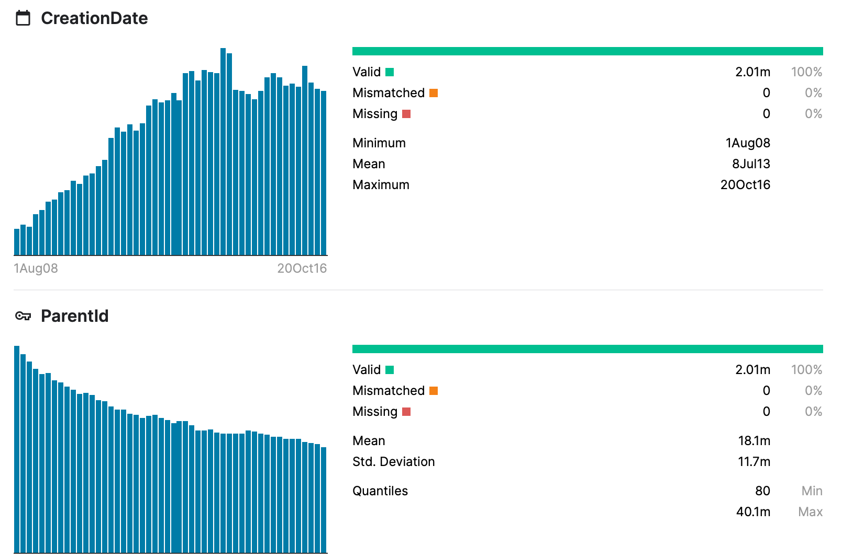
Dataset
Answers contain the body, creation date, score, and owner ID for each of the answers to these questions. The ParentId column links back to the Questions table

Slide 9
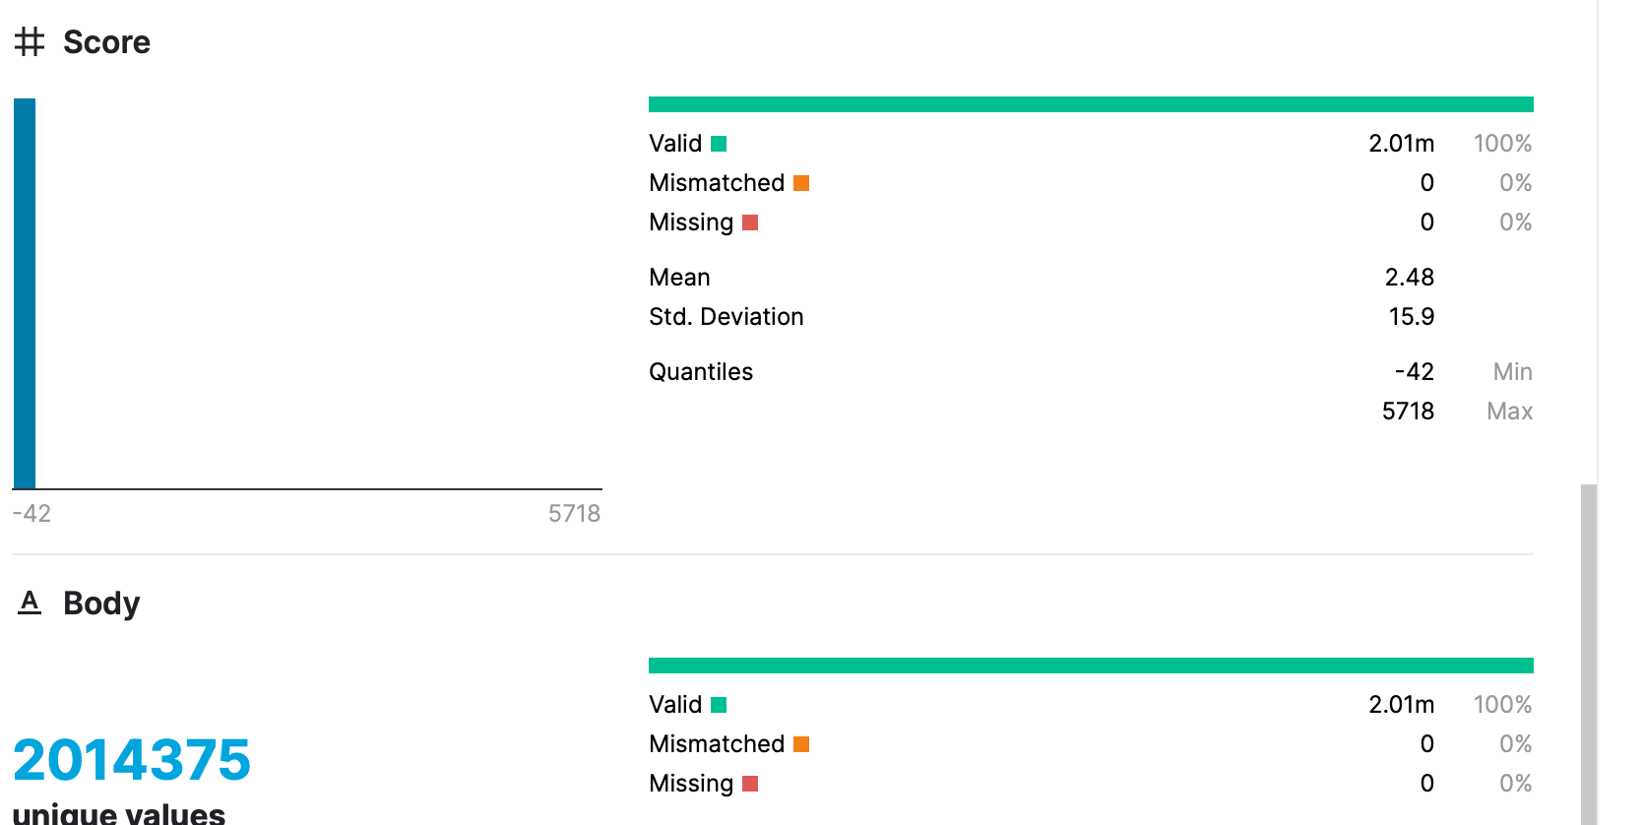
Dataset
cont…

Slide 10
Model Building
Data Preparation
Data Cleaning
Data Transformation
Modelling
Results.

Slide 11
Data Preparation
loading the datasets
checking for null values in the dataset, no null values were found in the dataset.
The tag are converted into string data type. Then tags are grouped based on their id.
From the questions dataset OwnerUserId, CreationDate, ClosedDate are dropped.
Then the questions dataset is merged with tags dataset.
A new dataset is formed by excluding all the rows whose score is less than 5.

Slide 12
Data cleaning
We are checking for the null and duplicate values in the new dataset.
Id and score are dropped from the new dataset.
the tags are then split into and stored in array format for a particular row.
Two new lists of frequent and unique tags are created.
In the new dataset we are retaining the most common tags and then if any tag value is null they are dropped.
Then beautiful soup is used to extract HTML text in the body column.
The abbreviations in the body column are expanded.
The punctuations are filtered out from body.
Then lemmatization is performed and stop words are removed.

Slide 13
Data Transformation
Using Term Frequency Inverse Document Frequency we are forming the vector representation of the given text.
Then LDA is performed to pick important words from the sentence.
These important words are segregated into 20 topics with 10 words in each topic.
TFIDF vectorizer is applied on body and tittle to avoid deletion of words like c# or .net
Now these vectorized values are combined and are split into test and train datasets.

Slide 14
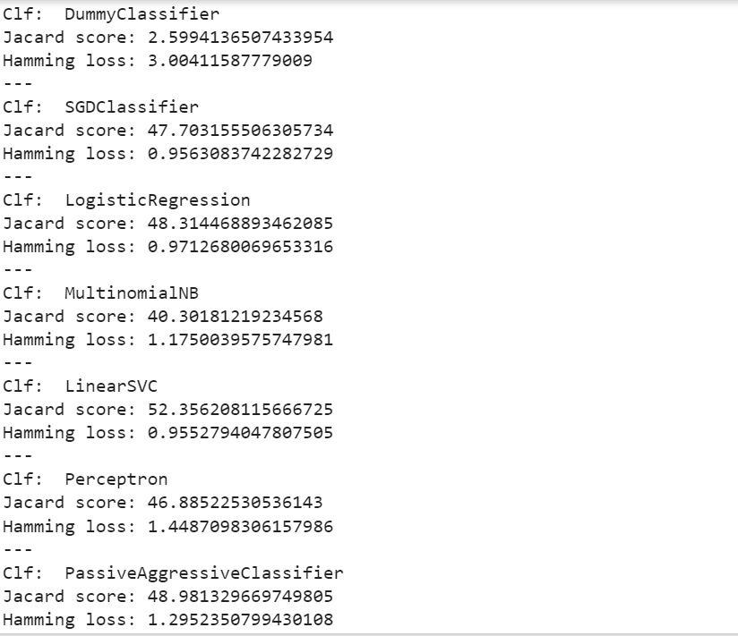
Modeling
We are using different classifiers to calculate the jaccard score and hamming loss to analyse the performance.

Slide 15
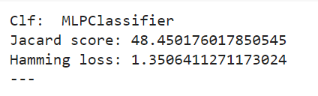
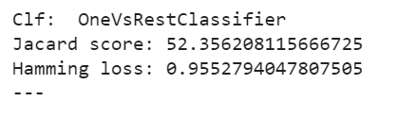
Modelling(cont..)

Slide 16
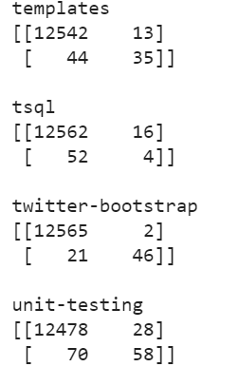
Result
Finally we are selecting OneVsRestClassifier classifier.
GridSearch CV is applied on OneVsRestClassifier.
A confusion matrix is generated to get an account of all the tags that are predicted correctly.

Slide 17
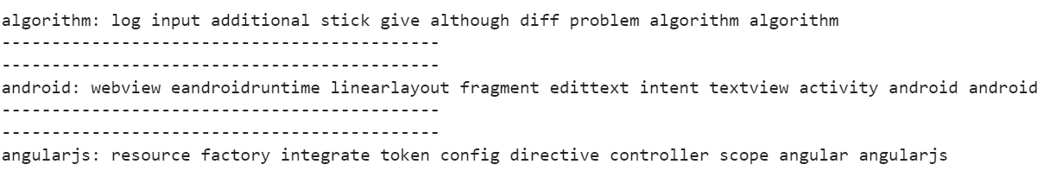
Result (cont..)
Extracting feature importance of all tags.

Slide 18
Thank You

